Slide 1

Safe Touch
Your Body Belongs To You!

Slide 2
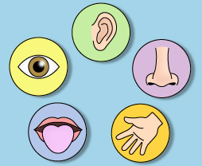
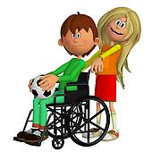


We are all born with something wonderful!
Not all of our senses may work we may be deaf, not see well, or be able to talk or even smell. We may need help to move or to do things!
It has up to five senses:
Smell Touch
Hearing Taste
Sight
It’s our body!

Slide 3
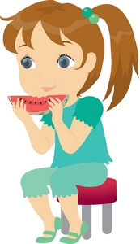
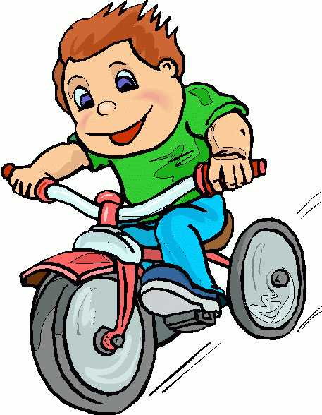



Our bodies allow us to do many things such as –
Playing with friends or toys
Doing sports like football, cycling and running
Eating
Sleeping
Learning / School work
Growing
Feeling happy and sad

Slide 4
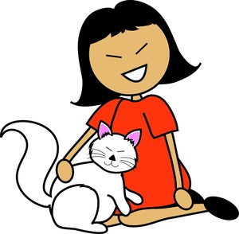
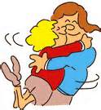


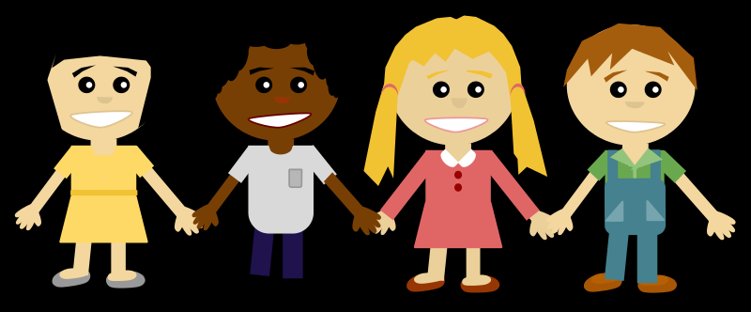
Your body is all yours. You can choose what you do with it.
Like –
Cuddling a pet
Holding hands
Hugging
Tickles that make you giggle
These are good touches.
They make us feel happy and safe.

Slide 5
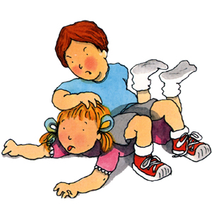
Sometimes touches don’t feel good………
Like when –
Someone pushes you
Someone hits you
Someone pulls your hair
Then you have to shout “STOP”!
You are in charge of your body.
You decide which touches feel
safe and good, and which ones feel unsafe and bad.

Slide 6

Some parts of your body are private.
These are the parts that you cover with clothes;
even when you go swimming.

Slide 7

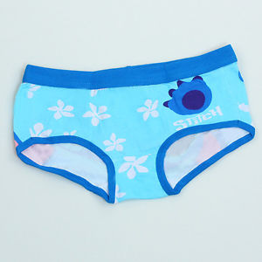



Remember the Underwear Rule………………
Privates are Private
Always remember your body
belongs to you
No means No
Talk about secrets that upset you
Speak up, someone can help
NSPCC

Slide 8
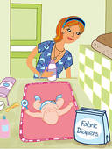
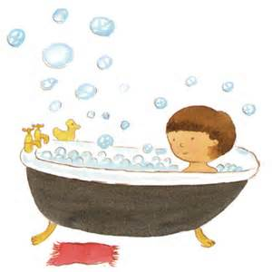

When you were a baby your parents touched your private parts
when they changed your nappy and took care of you.
Sometimes now you are older your parents still need to help with keeping you clean, washing and making sure you brush your teeth.
Sometimes you may need to be taken to see a doctor or nurse when you are hurt or poorly to be examined, but you can always have your parent or trusted carer to be with you if this happens.

Slide 9

If someone asks you take off your clothes
and wants to touch
your private parts
Say:
If Someone askes you to look at
or touch their private parts say:
“No, I won’t do that”!
“No, I don’t want to”!

Slide 10
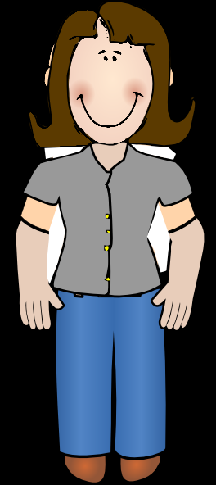




But, if anyone wants to touch your private parts in a way that makes you feel
upset say “NO” and tell someone you trust.
Like –
Your parents
Teacher
Doctor
Friend’s parent
Police officer
Social Worker

Slide 11

If someone tells you that you will be a bad child if you don’t touch them
or look at their private parts say
If someone tells you that their
touches are secret say:
“No, I don’t believe that”!
“No, I don’t like secrets like that”!

Slide 12

If anyone makes you feel unsafe or uncomfortable: Run Away from them if you can!
Scream! Shout! or Yell!
to get someone’s attention.
Do anything you can to make
people notice!
Tell your parents or another adult you can trust straight away.

Slide 13

Remember your body is special and it’s all yours!
You don’t have to let anyone
touch it in ways that make you feel bad.

Slide 14


