Slide 1
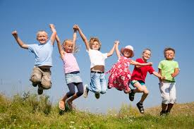

Safe Touch
Your Body Belongs To You

Slide 2



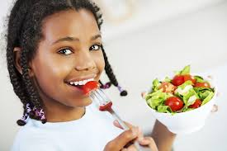
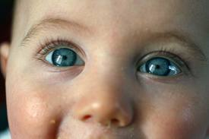
We are all born with something wonderful!
It can have up to fives senses –
Smell Touch
Hearing Taste
Sight
It’s our body!

Slide 3

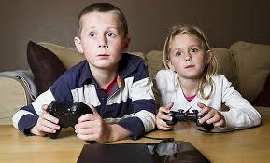
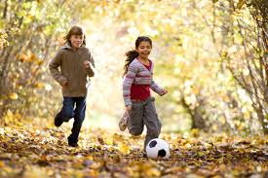


Our bodies allow us to do many things such as –
Playing with friends or toys
Doing sports like football, cycling and running
Eating
Sleeping
Learning / School work
Growing
Feeling happy and sad

Slide 4



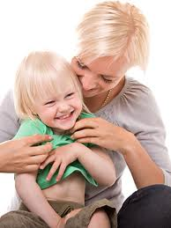
Your body is all yours. You can choose what you do with it.
Like –
Cuddling a pet
Holding hands
Hugging
Tickles that make you giggle
These are good touches.
Good touches make us feel happy and safe.

Slide 5
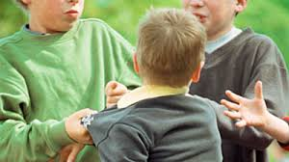
Sometimes touches don’t feel good…………….
Like when –
Someone pushes you
Someone hits you
Someone pulls your hair
Then you have to shout “STOP”!
You are in charge of your body. You decide which touches feel safe and good,
and which ones feel unsafe and bad.

Slide 6
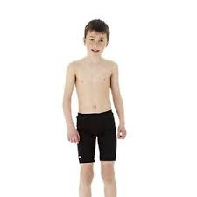
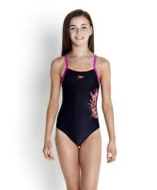
Some parts of your body are private. These are the parts that you cover with clothes;
Even when you go swimming.

Slide 7
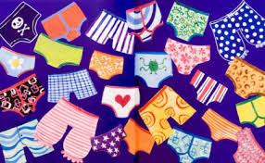
Remember the Underwear Rule……………………………………………..
Privates are Private
Always remember your body belongs to you
No means No
Talk about secrets that upset you
Speak up, someone can help
(NSPCC)

Slide 8
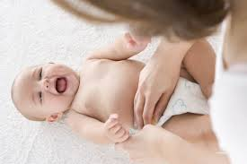

When you were a baby your parents touched your private parts when they changed
your nappy and took care of you.
Sometimes you may need to be taken by your mum or dad to see a doctor or nurse
when you are poorly.

Slide 9


But, if anyone wants to touch your private parts in a way that makes you feel upset
Say “NO” and tell someone you trust.
Like –
Your parents
Teacher
Doctor
Friend’s parent
Police officer
Social Worker

Slide 10

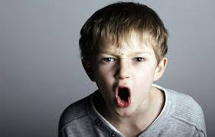
If someone asks you take off your clothes and wants to touch your private parts
say “No, I won’t do that”!
If someone asks you to look at or touch their private parts say
“No, I don’t want to”!

Slide 11

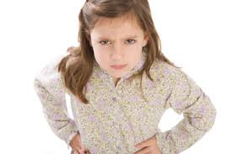
If someone tells you that you will be a bad child if you don’t touch them or look at their
Private parts say “No, I don’t believe that”!
If someone tells you that their touches are secret say
“No, I don’t like secrets like that”!

Slide 12
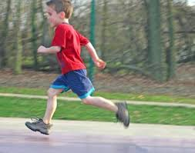
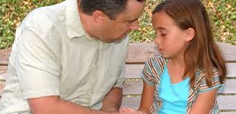
If anyone makes you feel unsafe or uncomfortable run away from them as soon as
you can, shout, scream and do what you can to get away or get attention.
Tell your parents or another adult you can trust straight away.

Slide 13

Remember your body is special and it’s all yours! You don’t have to let anyone touch
it in ways that make you feel bad.

Slide 14





Online Safety

Slide 15
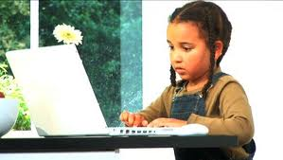
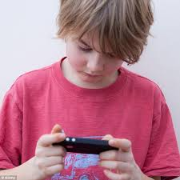
Sometimes it may not be a touch that makes you feel unsafe or uncomfortable, but a
person may ask you to do something that makes you feel that way.
Someone may ask you to send a photo of your body. It may seem like they are a friend
but you should say “No I Won’t do that”.

Slide 16


If anyone asks you to do this tell an adult you trust straight away.
Parents
Teacher
Friend’s parent
Police officer
Social worker
Doctor

Slide 17
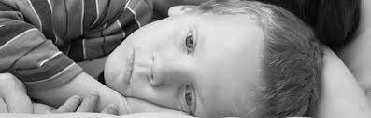
It’s against the law!
If you're under 18, it's illegal to take or share an ‘indecent’ picture of yourself,
or to look at or share someone else's.. If it’s naked or contains private parts it will
be 'indecent'!
Once a photo has been taken and sent to someone it can never be taken back and can
be seen by anybody.

Slide 18
Video
https://www.youtube.com/watch?v=_o8auwnJtqE

Slide 19

Remember your body belongs to you.

